Slide 1
Introduction to Linux command line for bioinformatics
Wenjun Kang, MS
Jorge Andrade, PhD
6/28/2013
Bioinformatics Core, Center for Research Informatics, University of Chicago

Slide 2
Goals
The goal of this tutorial is to provide hands-on training basics of using Linux via the command line.
It addresses people who have no previous experience with Unix-like systems, or who know a few commands but would like to know more.

Slide 3
Topics
What’s Unix/Linux
Navigation
Directory and file operations
File transfer between computers
I/O redirection and pipe
Text extraction and manipulation
Shell scripts
Exercises

Slide 4
Unix/Linux
UNIX is the operating system of choice for engineering and scientific computing.
The variant of UNIX found at CRI is GNU/Linux.
CRI currently uses CentOS Linux. There are many other distributions (RedHat, Ubuntu, Debian)

Slide 5
Difference between Unix and Linux
Unix developed in the late 1960s and Linux in the early 1990s based on Unix-like system MINIX
Linux is a UNIX clone
Linux is an operating system kernel
The terms are often used interchangeably

Slide 6
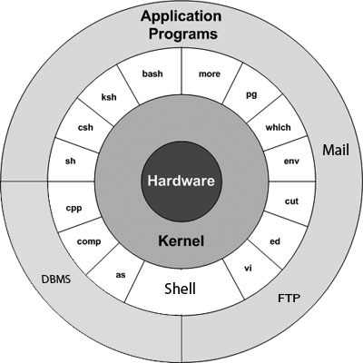
Unix Architecture
Kernel: The heart of the operating system
  It interacts with hardware.
  Memory management, task scheduling and file management.
Shell: The utility that processes your requests.
  the shell interprets the command and calls the program that you want.
Commands and Utilities:
  Eg: cp, mv, cat and grep etc.
Files and Directories:
  All data in UNIX is organized into files.
  All files are organized into directories.
  These directories are organized into a tree-like structure called the filesystem.

Slide 7
Connect to a Linux Machine
Remote to a Linux machine via ssh
  From MAC: $ ssh username@bios.cri.uchicago.edu
  From PC: use Putty to connect
--(criwksp35@ln01)-(~)--
User Name
Machine Name
Current Directory

Slide 8
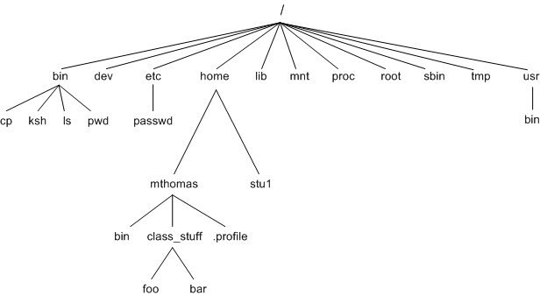
CRI File System
group
grp1
grp2

Slide 9
Anatomy of a Linux Command
$ ls -l -r -s /tmp
ls (command or utility or program)
-l -r -s (options, or flags –control the flavors of the command)
/tmp (argument – what is been operated on)

Slide 10
Navigation
Commands: cd, ls, and pwd
  cd /
  cd /tmp
  ls
  ls q*
  pwd
  ls -l
  cd ~

Slide 11
Handy shortcuts
Anywhere in Command Line:
  up(down)_key - scrolls through command history
Auto Completion:
  <something-incomplete> TAB
When specifying file names:
  ".." (dot dot) - refers to the parent directory
  "~" (Tilda) or "~/" - refers to user's home directory
  “*” (star) - refers to any file names

Slide 12
Directory and file operations
Create a new directory
  mkdir mydir1
Create a new file in a directory
  cd mydir1
  nano file1.txt
Copy a file
  cp file1.txt file1_copy.txt
Delete a file or directory
  rm file1_copy.txt
  rm -r folder1

Slide 13
Directory and file operations
Rename a file or folder
  mv file1.txt file12.txt
  mv folder1 folder2
Move file from one folder to another
  mv folder1/file1.txt folder2
Compress files
  gzip, and gunzip

Slide 14
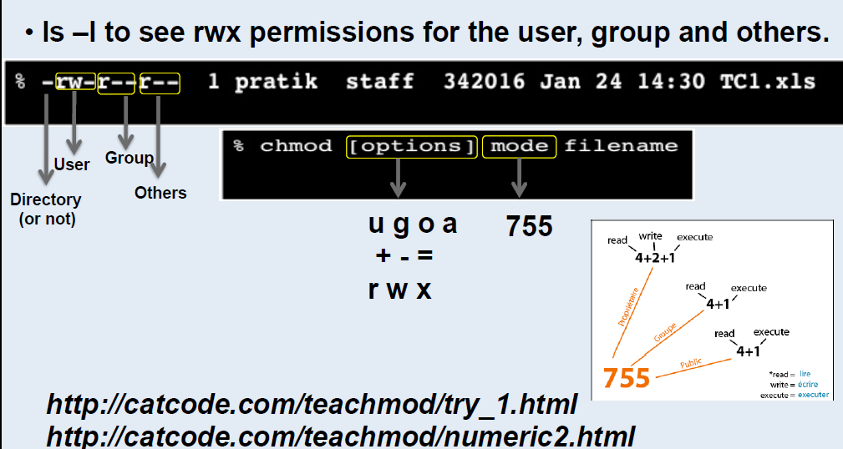
File Permissions

Slide 15
File transfer between computers
Winscp (between Windows and Linux)
scp (else)
  scp file1.txt user@bios.cri.uchiago.edu:.
wget url
  wget http://downloads.yeastgenome.org/curation/chromosomal_feature/saccharomyces_cerevisiae.gff

Slide 16
I/O redirection and pipe
> file, Output re-direction, overwrite
  cat file1.txt > file2.txt
>> file, Output re-direction, append
  cat file1.txt >> file2.txt
< file, input re-direction
  cat < file1.txt
CommandA | command B, pipe output from CommandA to command B
  ls -l | wc -l

Slide 17
Text extraction and manipulation
Text Editor: vi, vim, nano, emacs, and others.
Text Viewers:
  less (more)
  head, and tail
Pattern Search
  grep “word” file.txt
  find . –name “somename”
Text replacement and text operation
  cat, sed, tr, and rev

Slide 18
Text extraction and manipulation
Table manipulation
  sort
  uniq
  cut
  awk
  paste
Count the number of word, lines and bytes
  wc

Slide 19
Shell Script
>nano hello.sh
> chmod u+x hello.sh
> ./hello.sh
#!/bin/bash
echo "Hello World!“

Slide 20
Questions?

Slide 21
Hands on Exercises
https://wiki.uchicago.edu/display/CRIwksp/

Slide 22
Basic Commands
Command | Meaning
ls (-artlh) | list files and directories
mkdir | make a directory
cd directory | change to named directory
pwd | display the path of the current directory
mv file1 file2 | move or rename file1 to file2
cp file1 file2 | copy file1 and call it file2
rm file | remove a file
rmdir | remove a directory
cat file | display a file
less file | display a file one page a time
head/tail file | display the first/last few lines of a file

